Slide 1
Observability Essentials for AI Platform
Sanket Sudake

Slide 2
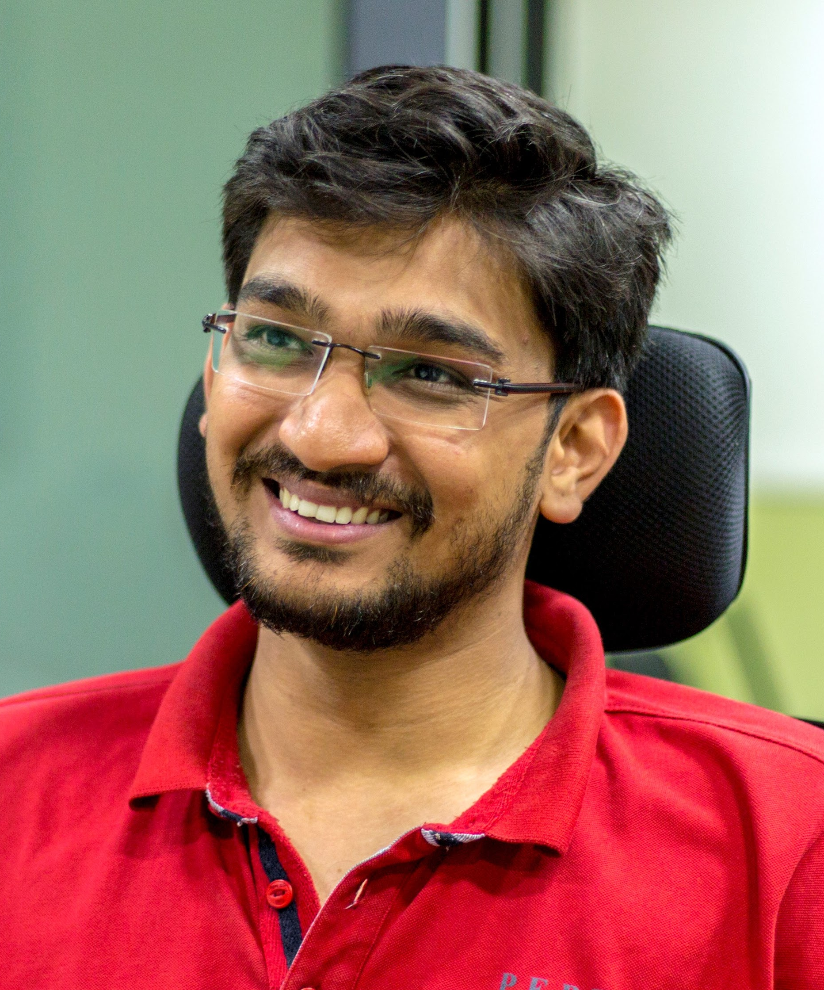
About Me @sanketsudake
Principal Engineer, InfraCloud
Interest Areas: AI, Cloud Native Platforms, Distributed Systems
Past: Started as Kernel Engineer
Worked as Go developer, Openstack developer, SRE
Maintainer Fission - Serverless
Recent AI projects
Agentic analysis of Source code repository
Multitenant large scale RAG
Building Large Scale AI Cloud

Slide 3
AI Observability

Slide 4
Need for AI Observability
AI Apps are becoming integral part of our workflows now
ChatGPT, Claude
Copilot, Cursor
Perplexity, Fireflies.ai
Sovereign AI
Private and secure data
Control over platform
Consider pharma, security, fintech use cases
Enterprise AI use cases
Performance is crucial
Specialized hardware utilization and observability
Insights into model performance, AI services
Adapting new models and innovations in a measurable way
Latency Sensitive workloads
Notes:
AI Apps are becoming integral part of our workflows now
ChatGPT, Claude
Copilot, Cursor
Perplexity, Fireflies.ai
Sovereign AI
Private and secure data
Control over platform
Consider pharma, security, fintech use cases
Enterprise AI use cases
Performance is crucial
Specialized hardware utilization and observability
Insights into model performance, AI services
Adapting new models and innovations in a measurable way
Latency Sensitive workloads

Slide 5
AI Platforms Overview

Slide 6
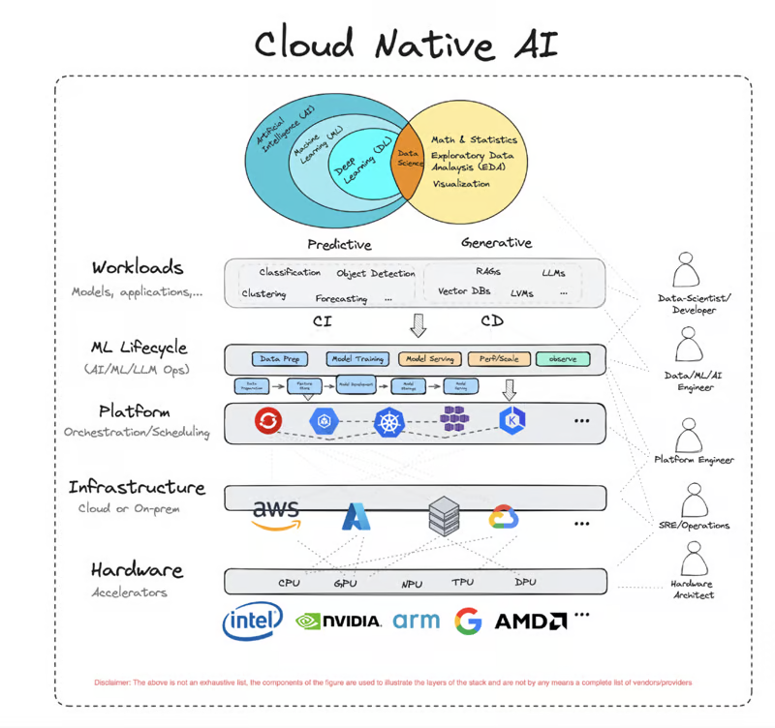
Generalist View
Notes:
Talk about different layers from bottom to up

Slide 7
Layer | Traditional Monitoring | AI Platform Monitoring
Workloads | Monitors static, predefined workloads with predictable resource usage. | Requires real-time monitoring of dynamic workloads with fluctuating resource demands and performance.
ML Lifecycle | Focuses on system health, uptime, and static performance metrics. | Continuously tracks model accuracy, drift, and data integrity across the ML lifecycle to ensure reliability.
Platform | Monitors a relatively uniform tech stack with limited variability. | Observes diverse, evolving AI frameworks and tools, requiring scalable and flexible monitoring solutions.
Infrastructure | Focuses on maintaining steady resource usage and system performance. | Monitors resource-intensive operations, optimizing GPU/TPU utilization and managing high-throughput AI processing.
Hardware | Tracks general-purpose hardware with basic performance metrics. | Requires specialized monitoring for AI-specific hardware, including GPUs and TPUs, with focus on utilization, temperature, and performance.
Notes:
Layer
Traditional Monitoring
AI Platform Monitoring
Workloads
Monitors static, predefined workloads with predictable resource usage.
Requires real-time monitoring of dynamic workloads with fluctuating resource demands and performance.
ML Lifecycle
Focuses on system health, uptime, and static performance metrics.
Continuously tracks model accuracy, drift, and data integrity across the ML lifecycle to ensure reliability.
Platform
Monitors a relatively uniform tech stack with limited variability.
Observes diverse, evolving AI frameworks and tools, requiring scalable and flexible monitoring solutions.
Infrastructure
Focuses on maintaining steady resource usage and system performance.
Monitors resource-intensive operations, optimizing GPU/TPU utilization and managing high-throughput AI processing.
Hardware
Tracks general-purpose hardware with basic performance metrics.
Requires specialized monitoring for AI-specific hardware, including GPUs and TPUs, with focus on utilization, temperature, and performance.

Slide 8
Platform vs Consumer
Code
API Client
AI Frameworks
(Tensorflow, Pytorch)
Inference Servers
(Triton, KServe)
Containers
Containers
AI Notebooks
Model Catalog
Consumed by Platform User
Operating System
(SSH access)
Orchestration Layer
Orchestration Layer
Orchestration Layer
Platform
provider
GPU Instances
GPU Instances
GPU Instances
GPU Instances
Service | Machines | Deployments | Dev Spaces | LLM API
Target User | Sysadmin, DevOps | Data Scientists, Developers | Data Scientist, Developer | Developers

Slide 9
AI Inferencing Observability
Critical services and expanding bucket
Generation(Text, Image, Video, Speech)
Embeddings (RAG use cases)
Reranker
Prompt Guard
Vector databases
Works very differently from traditional microservices
Requests are batched and passed to a model
Processing Limited by GPU memory
Vector databases
Notes:
Critical services and expanding bucket
Generation(Text, Image, Video, Speech)
Embeddings (RAG use cases)
Reranker
Prompt Guard
Vector databases
Works very differently from traditional microservices
Requests are batched and passed to a model
Processing Limited by GPU memory
Vector databases

Slide 10
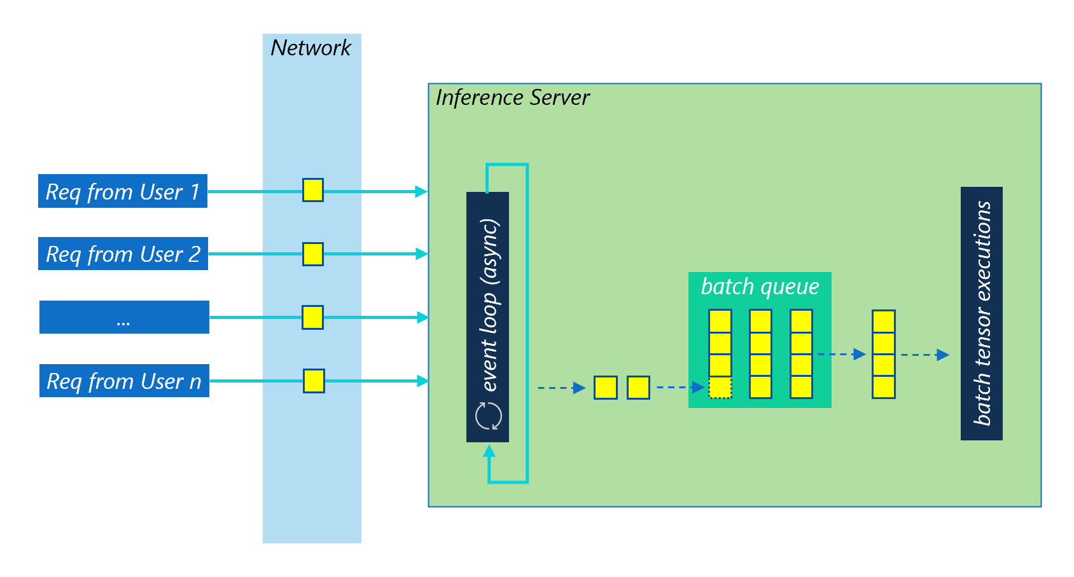
Prompt
LLM
Batch Inference Serving
Notes:
Batching from inference serving

Slide 11
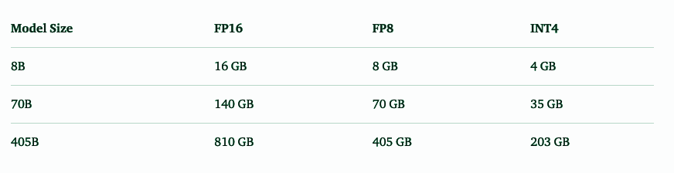
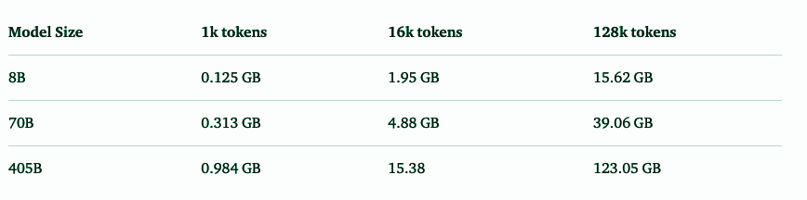
Inference Memory (LLAMA 3.1 Models)
Notes:
Inference requirements for LLMA 3.1 models

Slide 12
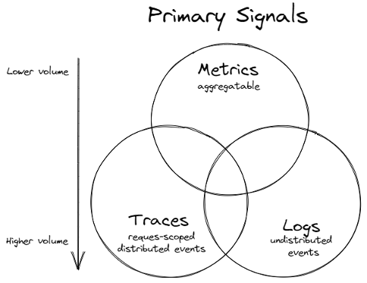

Slide 13
Metrics
Inference
Throughput (Token/sec, higher the better)
TTFT (time to first token, lower the better)
ITL (inter-token latency, lower the better)
Request Prompt Length/ Generation Length
Cache utilization
GPU
Framebuffer memory (free vs used)
GPU to Memory and Memory to GPU copy
GPU to GPU communication (In/Out metrics)
Utilization (higher the better)
Temperature
Clock frequency
Power Consumption
Notes:
https://buildkite.com/vllm/performance-benchmark/builds/4068
Inference
Throughput (Token/sec, higher the better)
TTFT (time to first token, lower the better)
ITL (inter-token latency, lower the better)
Request Prompt Length/ Generation Length
Cache utilization
GPU
Framebuffer memory (free vs used)
GPU to Memory and Memory to GPU copy
GPU to GPU communication (In/Out metrics)
Utilization (higher the better)
Temperature
Clock frequency
Power Consumption

Slide 14
Logs
GPU stack
Containerd
GPU driver
Device Plugin
Container Toolkit
Node feature discovery
NCCL
Services logs
Inference servers
Request ID = 12345, Response Time = 85ms, Status = 200 OK
Vector db
Long Running Jobs - Troubleshooting
Training jobs
Data processing/Pipeline jobs
Fine tuning jobs
Notes:
GPU stack
Containerd
GPU driver
Device Plugin
Container Toolkit
Node feature discovery
NCCL
Services logs
Inference servers
Request ID = 12345, Response Time = 85ms, Status = 200 OK
Vector db
Long Running Jobs - Troubleshooting
Training jobs
Data processing/Pipeline jobs
Fine tuning jobs

Slide 15
Traces
AI Applications
Agent Apps
RAG
LLM Calling chains
RLHF
User Query => Model Prediction => User Feedback
Resource allocation
Jobs/Pods => GPU profile matching => Allocations/Usage
Model Execution
Preprocessing => Batching => Post processing
Data Flow
Data ingestion => Transformation => Input/Usage
Notes:
AI Applications
Agent Apps
RAG
LLM Calling chains
RLHF
User Query => Model Prediction => User Feedback
Resource allocation
Jobs/Pods => GPU profile matching => Allocations/Usage
Model Execution
Preprocessing => Batching => Post processing
Data Flow
Data ingestion => Transformation => Input/Usage

Slide 16
Tools (Metrics)
Prometheus
Grafana
Nvidia DCGM
Tensorflow profiler
Kube-prometheus-stack
AI/ML jobs specific (W&B or similar)
Hyperparameter tuning tracking
Pretraining/Fine tuning jobs
Data Pipelines
Notes:
Prometheus
Grafana
Nvidia DCGM
Tensorflow profiler
Kube-prometheus-stack
AI/ML jobs specific (W&B or similar)
Hyperparameter tuning tracking
Pretraining/Fine tuning jobs
Data Pipelines

Slide 17
Tools (Logs)
ELK
Loki
Fluend
Filebeat
Tensor Board
Notes:
ELK
Loki
Fluend
Filebeat
Tensor Board

Slide 18
Tools (Tracing)
Opentelemetry
Collectors
Jager
Zipkin
LLM Gateway
Notes:
Opentelemetry
Collectors
Jager
Zipkin
LLM Gateway

Slide 19
Demo

Slide 20
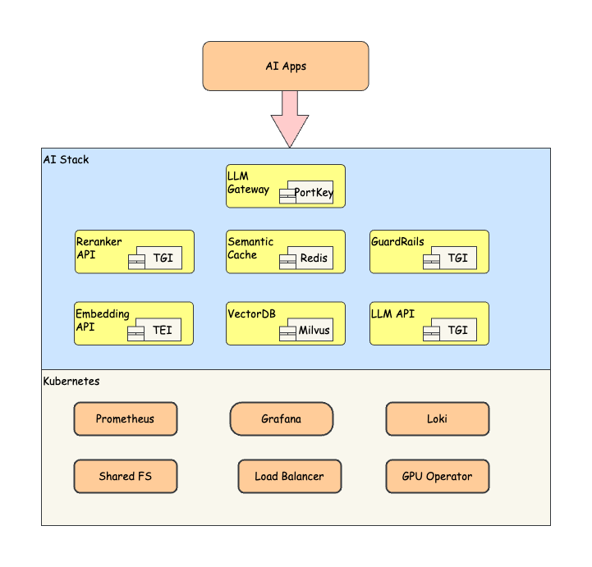
AI Stack (HF Services)

Slide 21

AI Stack(NIMs)

Slide 22
Setup
Kubernetes Cluster
1 master, 4 worker nodes
GPU workers
Intel i9 14000KS 3.2GHz/24C/32MB
1 TB NVME SSD
Nvidia 24 GB Card
2 TB HDD
1/10 Gbps interconnect
NFS
Intel Nucs
Model Registry, Docker images
Notes:
Kubernetes Cluster
1 master, 4 worker nodes
GPU workers
Intel i9 14000KS 3.2GHz/24C/32MB
1 TB NVME SSD
Nvidia 24 GB Card
2 TB HDD
1/10 Gbps interconnect
NFS
Intel Nucs
Model Registry, Docker images

Slide 23



Thank you :-)
@SanketSudake

